Slide 1
Dynamic Academic Course Advisor CTIS (440 Capstone)

Slide 2
Basic
The CTIS Information Portal will centralize and analyze data across multiple academic sources including the CTIS and Cyber and Network Security (CNS) programs. The platform will help users understand:
- Which courses are required or recommended for each major.
- Instructor information and contact details.
- Credit hours, prerequisites, and recommended prior knowledge.
- Course availability/eligibility per semester.
- Student and alumni profiles (optional user-generated content).
- Advisory-style planning, and recommendations
Also, this system will incorporate AI-powered insights (via Amazon Bedrock) to generate personalized recommendations for students such as ideal course paths, preparation advice, or related resources.

Slide 3

CLOUD Architecture:
Frontend: React-based web interface hosted on Amazon S3 + CloudFront (static website hosting).
Backend/API Layer: Amazon API Gateway to handle REST API requests.
Compute Services: AWS Lambda for backend logic.
Database Layer: Amazon RDS (for structured catalog data) and DynamoDB (for dynamic user profiles and session data).
AI/ML Integration: Amazon Bedrock API for generating course insights or student-specific recommendations.
Infrastructure as Code: Deployment via Terraform or AWS CloudFormation for reproducibility and scalability.
(AWS - FREE TIER USAGE)

Slide 4

Kevins Requirements:
Security: AWS IAM roles control access to the database and API.
Reliability: Multi-AZ RDS database ensures uptime.
Performance Efficiency: Static hosting (S3 + CloudFront) improves load speed.
Cost Optimization: Serverless (Lambda) reduces unused compute cost.
Operational Excellence: Logging and CloudWatch give insights for improvements.

Slide 5
Data Flow
React Frontend (multi-page)
↓
CloudFront + S3 (hosting + CDN) (NOT HERE YET)
↓
API Gateway (REST API)
↓
Lambda (Node.js)
↓
RDS Postgres (private subnet)
↓
Bedrock (AI model)

Slide 6
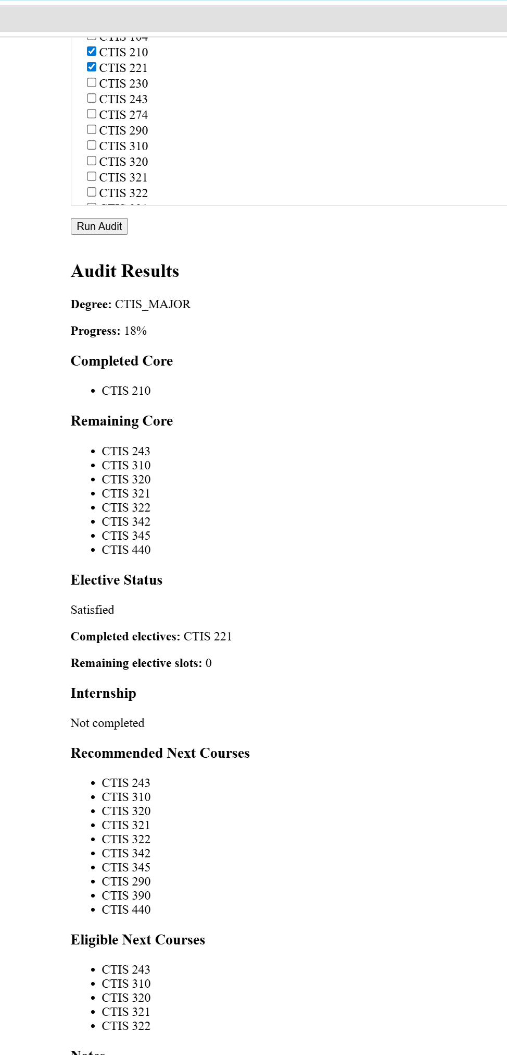
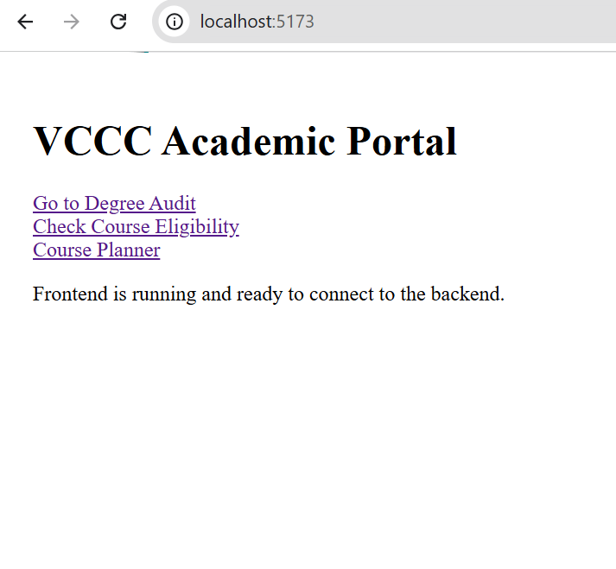
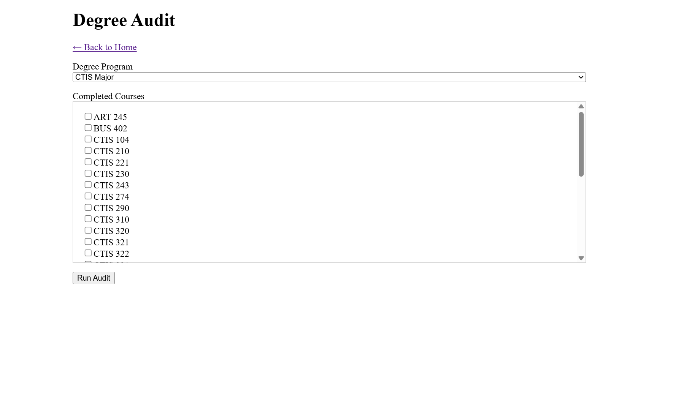
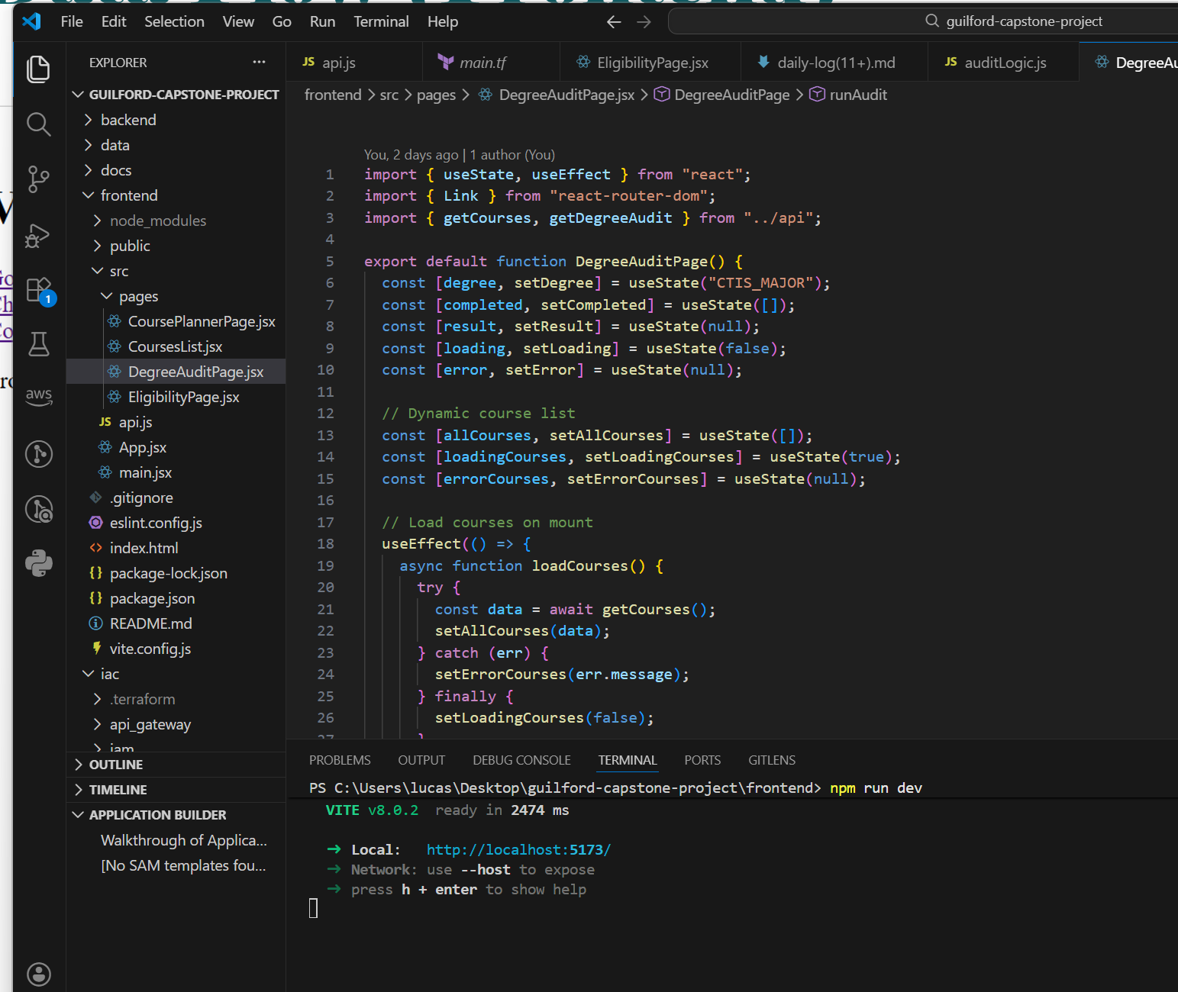
Data Flow (Frontend)

Slide 7
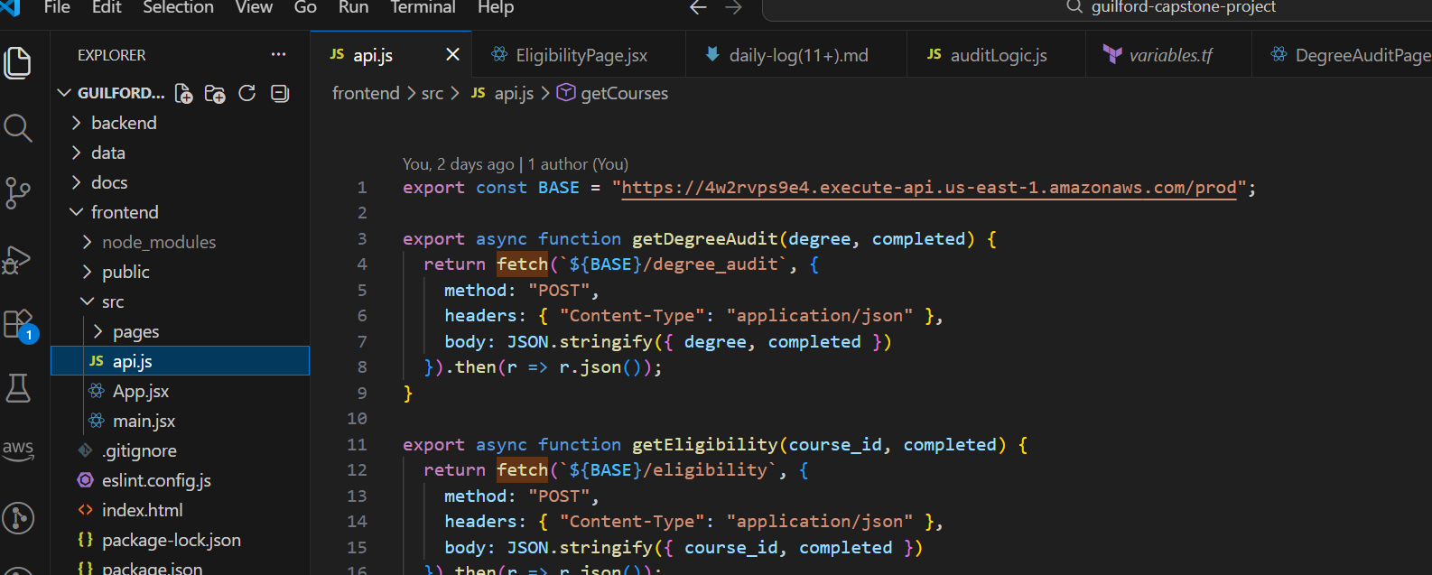
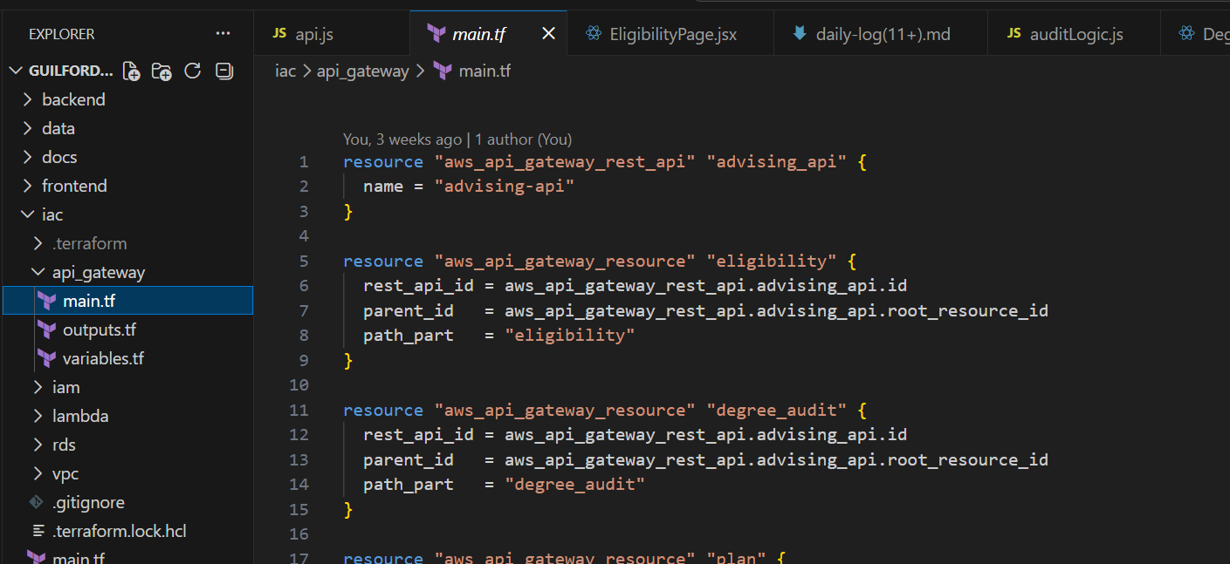
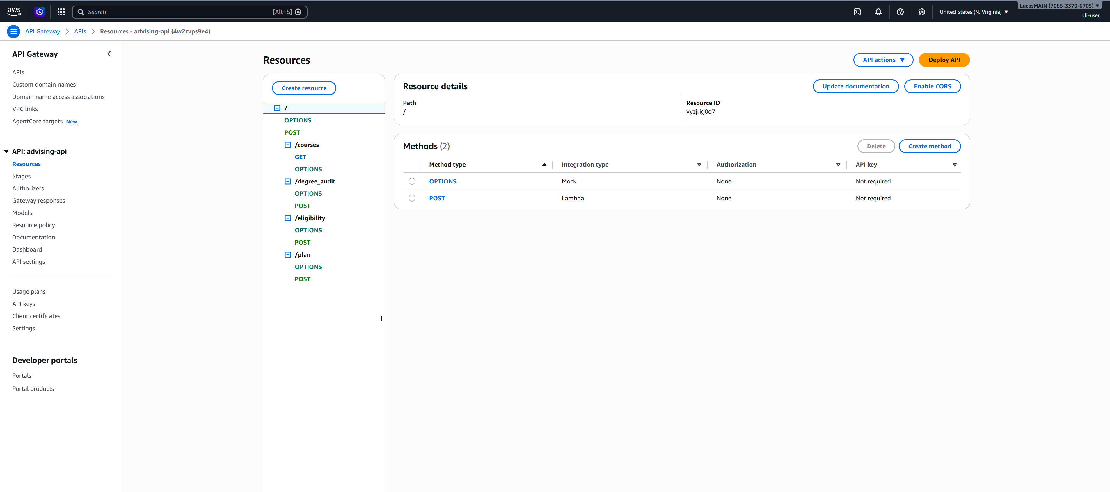
Data Flow (API Gateway)

Slide 8
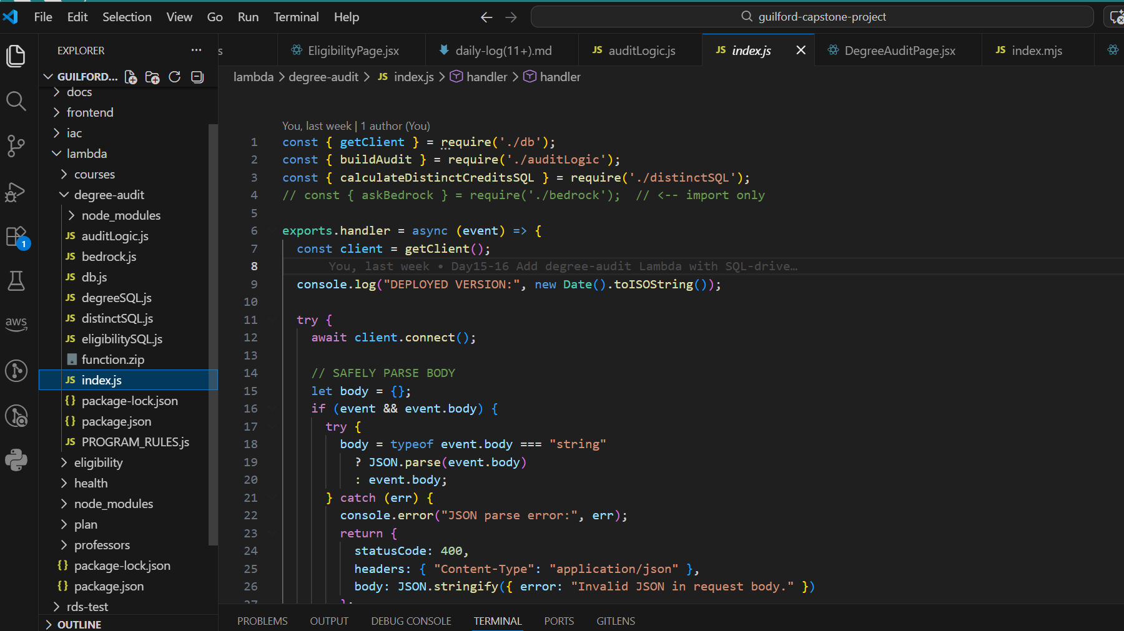
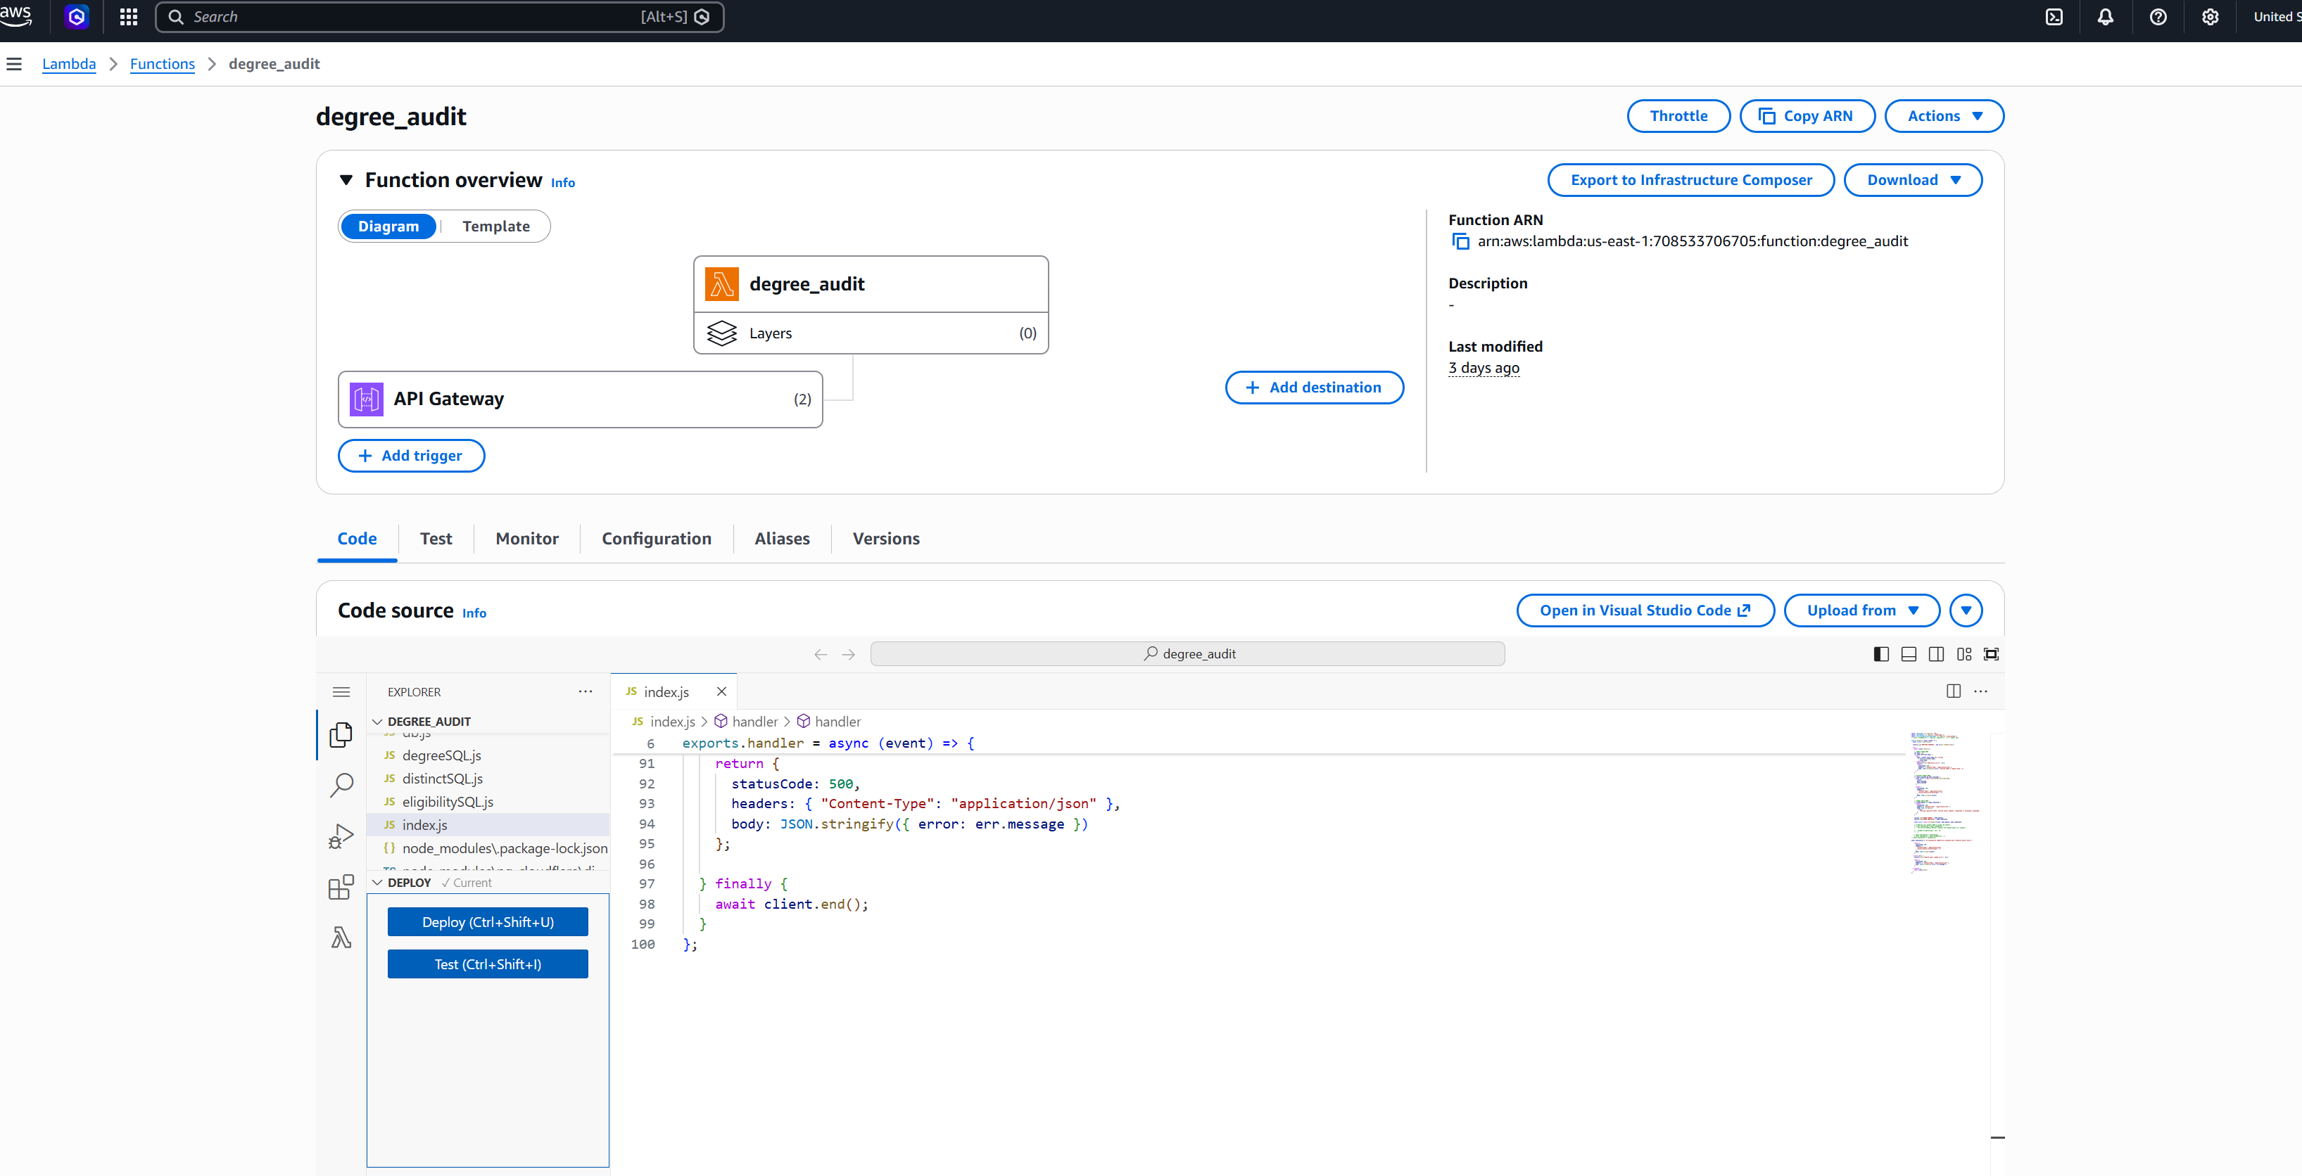
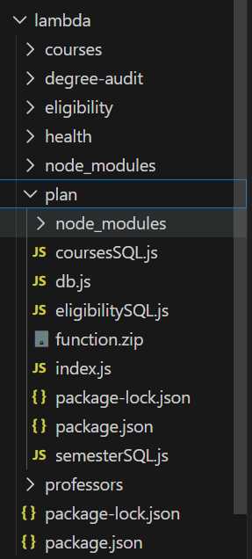
Data Flow (Lambda)

Slide 9
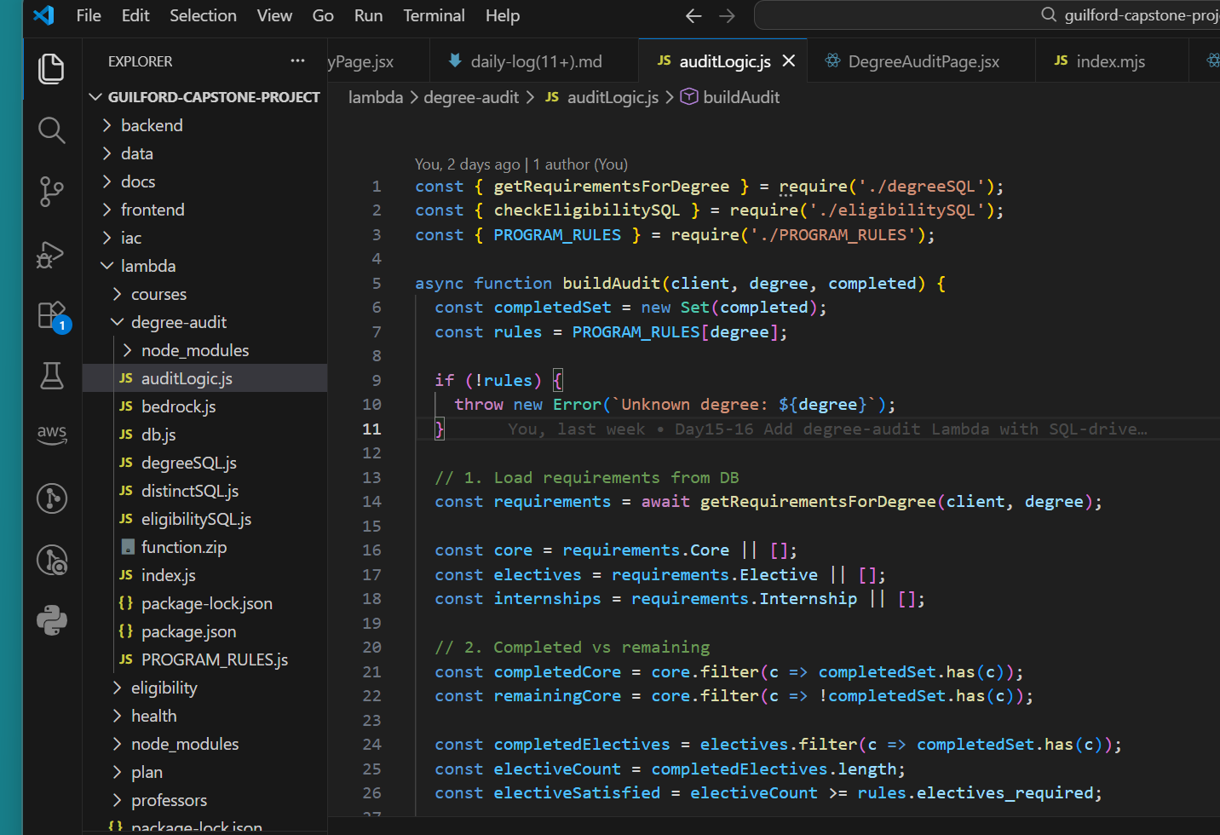
IAC
Backend
Data
Docs
Frontend
IAC
Lambda

Slide 10
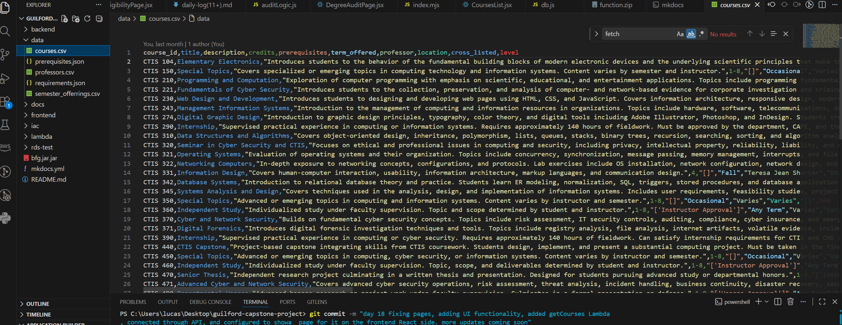
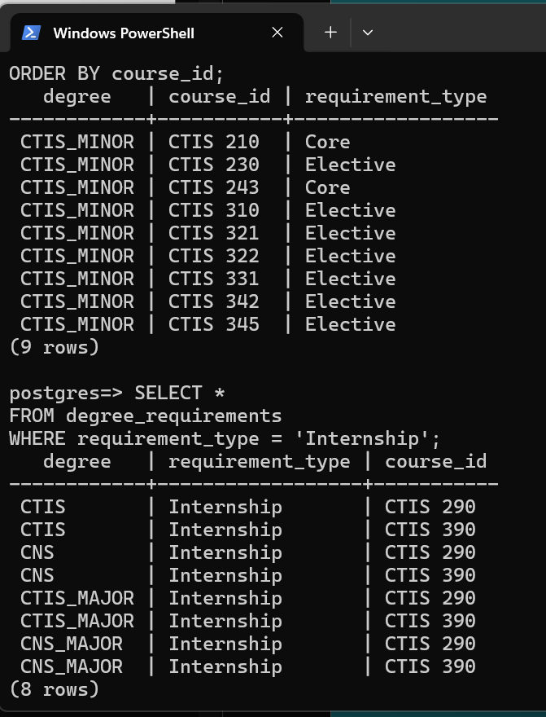
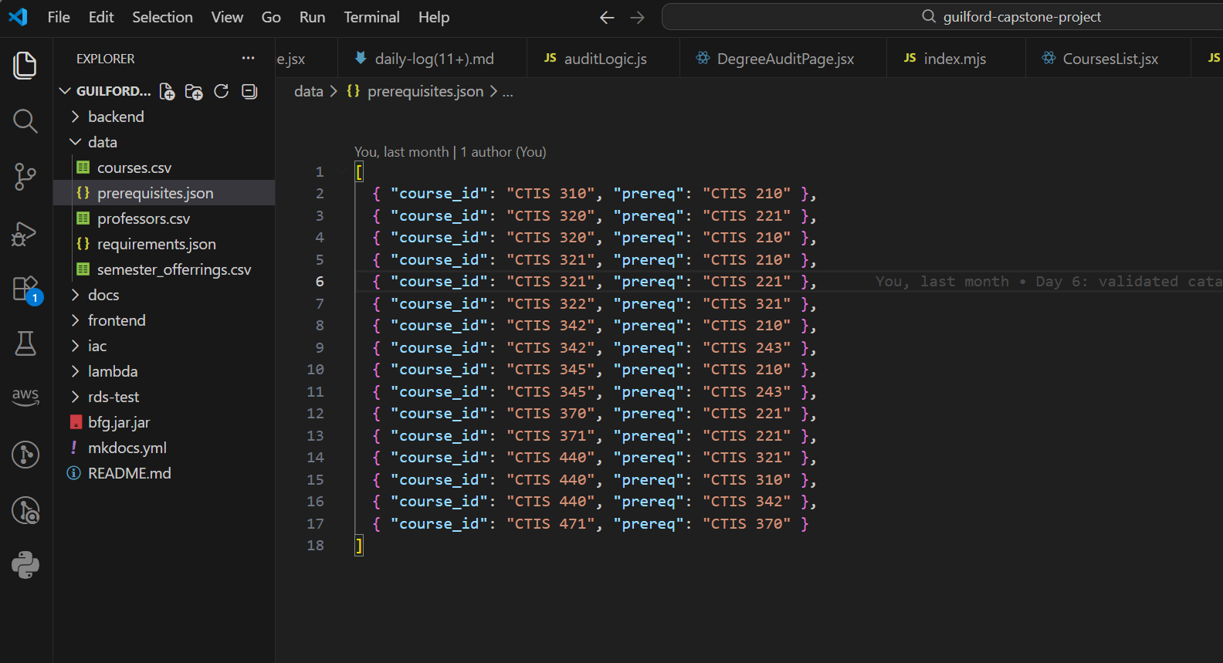
Database
(RDS
Postgres)

Slide 11
Where I am
85% complete (DB, Backend, Logic, API, Endpoints)
Finish Frontend, (pages, endpoints, UI-friendly, fully functional)
Deploy onto S3
Add in AI Bedrock advisory/responses for Users
OPTIONAL (IF I GET THERE):
Increase services, capabilities,
Develop App version
Add Alumni page/users (database increase as well)

